Slide 1

BFX AT-100 – FA Report for 5 RMA Units, No Boot Issue
PE : Nam
Date: 2022/11/21

Slide 2
#1
Problems Description
Issue Description
When | 2022.10.01
Who | ALT customer
Where | Korean
What | ALT customer request to analyze 5 RMA units, no boot issue
Why | The root cause is P3V3 power was shorted with GND
How | Product can not boot
How many | Total 5pcs and detail as table below:
No# | NG1 sample | NG2 sample | NG3 sample | NG4 sample | NG5 sample
MAC | 38D57AD8588B | 38D57ADA242B | 4CD577FFEFFF | 38D57ADA046F | 38D57AD810F4
SN | 2149688001202201093490 | 2149688001202201206149 | 2149688001202201069841 | 2149688001202201204082 | 2149688001202201072761
Production Date | 2022.02.10 | 2022.04.22 | 2022.01.07 | 2022.04.02 | 2022.01.22
Issue | No boot | No boot | No boot | No boot | No boot

Slide 3
#2
RMA Analysis Plan
Step | Items | Contents | Owner | Status | Result
1 | Visual inspection | Inspect appearance of housing | PD: Van Anh | Done | No damaged or any abnormal
2 | Baking | Baking 24h at 45⁰C | PD: Van Anh | Done | N/A
3 | Re-test OBA function | Re-test function at OBA station | OBA: Tu | Done | 5/5 units can not boot
4 | Open housing & VI PCBA | Open housing and inspect PCBA | PE: Nam | Done | 4 units aren’t abnormal. 1 unit (NG5 sample) was burnt at R823, R824,R825, R826 locations. Therefore, can not further repair and analyze.
5 | Take X-ray | Take X-ray focus on: U1, U602, U801, U1101, U1001 locations | ME: Hugo | Done | PASS
6 | Failure Analysis of NG1~NG4 samples | Retest FATP | PE: Nam | Done | 4/4pcs no boot from UK station
 |  | Double check history record production data | PE: Nam | Done | No found abnormal
 |  | Measure impedance, voltage all power supplies | PE: Nam | Done | - For NG1+NG2: P3V3 (3.3V) and ETH_DVDD10 (1V) power supplies was shorted with GND. - NG3+NG4: P3V3 (3.3V) power supply was shorted with GND.
 |  | - For NG1+NG2 sample: Remove and measure impedance + VF of U801 location then compare with OK sample. - For NG3+NG4 sample: Remove & measure impedance + VF of U1 then compare with OK sample. | PE: Nam | Done | - For NG1+NG2: pins of U801 component relate to ETH_DVDD10 and P3V3 power supplies was shorted. - For NG3+NG4: all pins of U1 component relate to P3V3 supply was shorted.
 |  | - For NG1+NG2 sample: Changed new U801 (RTL8211F) then check boot up status. - For NG3+NG4 sample: Changed new U1 (S905X2 ) then check boot up status. | PE: Nam | Done | 4 units boot up normal.
7 | FATP | Re-test 4 RMA units at all test stations after changed new U801 and U1 material. | PD: Van Anh | Done | 4 units passed all test station.
8 | OBA test | Test function at OBA station. | OBA: Tu | Done | 4 units passed functional test at OBA station.

Slide 4







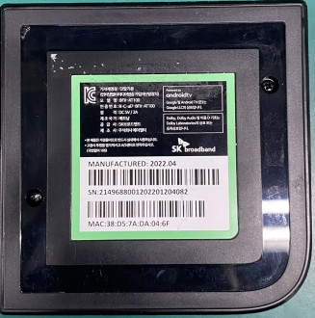
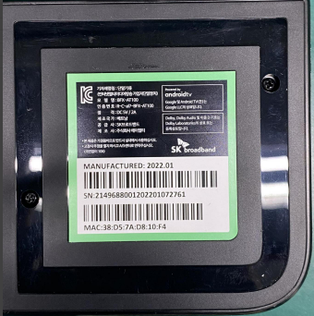
#3
Visual Inspection
Check appearance of housing
Visual Inspection Outside Housing
 | NG1 | NG2 | NG3 | NG4 | NG5
Top side
Bot side
Result: No found any damaged or abnormal.

Slide 5

#4
Re-test OBA Function
Baking 5pcs RMA 24h at 45⁰C.
Re-test function at OBA station.
Can not boot up
Result:
Baking 5pcs RMA 24h in 45⁰ (Done).
5pcs can not boot up when re-testing at OBA station.

Slide 6
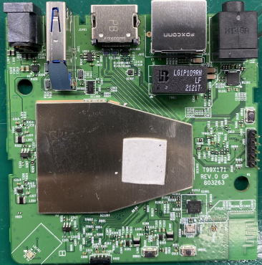
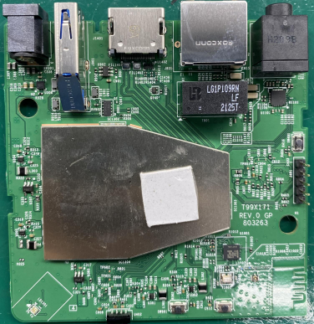
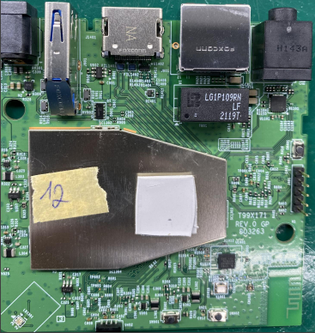
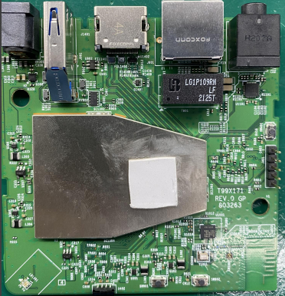
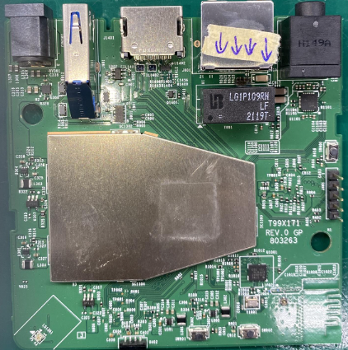
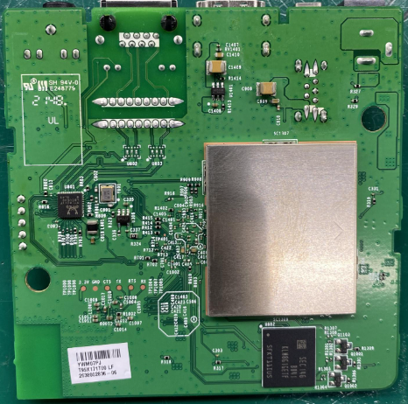
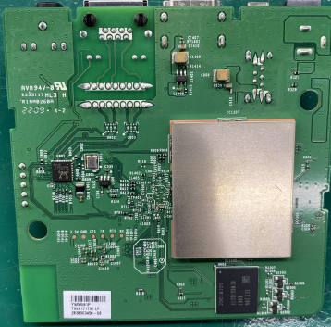
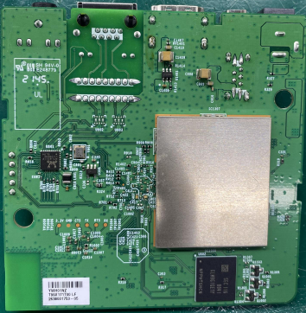
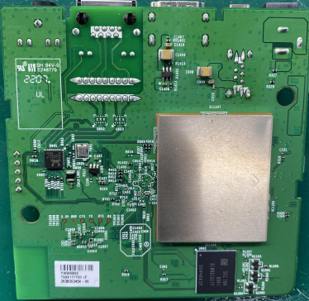
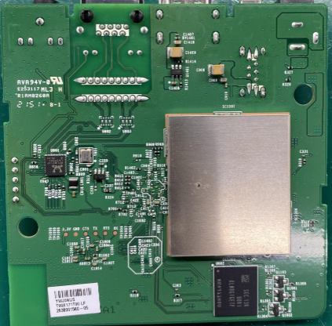
#5
PCBA Visual Inspection
Open housing and inspect PCBA, detail as table below:
NG sample | NG1 | NG2 | NG3 | NG4 | NG5
Top side
Bot side
VI Result | Pass | Pass | Pass | Pass | Burn at R823, R824, R825, R826 locations

Slide 7
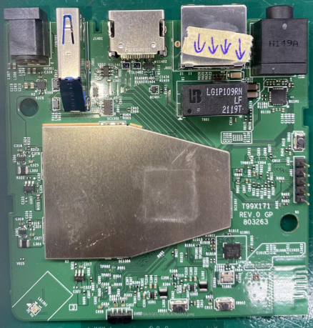
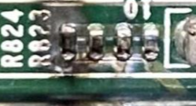
#5
PCBA Visual Inspection
Due to NG5 sample was burnt at R823,R824, R825, R826 locations ➔ Therefore, can not further repair and analyze.
Burnt locations
Result:
NG1 to NG4 samples is normal.
NG5 sample was burnt at 4 location, so can not further analyze..

Slide 8
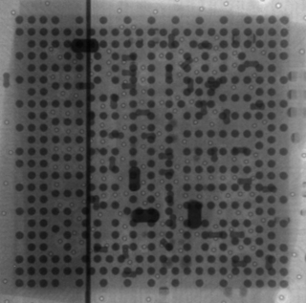
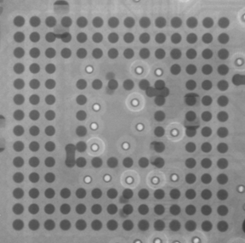
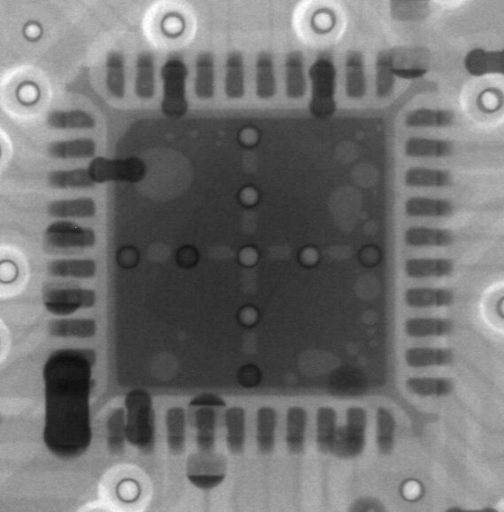
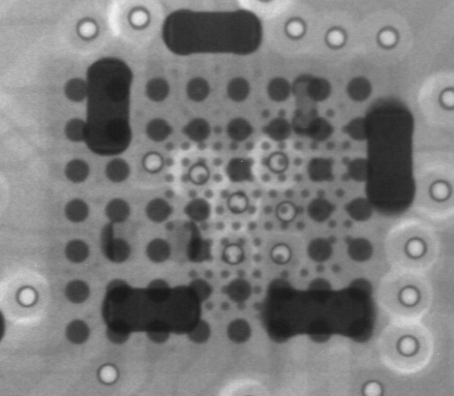
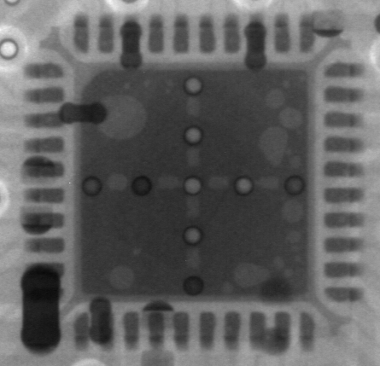
#6
Take X-ray
Take X-ray 5 locations : U1, U602, U1101, U1001, U801 of 5 NG samples, detail images as below:
NG# | Image
NG1
NG2
NG3
NG4
NG5
U1
U602
U1101
U1001
U801
U1
U602
U1101
U1001
U801
U1
U602
U1101
U1001
U801
U1
U602
U1101
U1001
U801
U1
U602
U1101
U1001
U801
Result: No found any abnormality.

Slide 9
#7
Failure Analysis
7.1 Re-test 5 NG samples at all test stations follow normal process.
UK
FT
FT1
RC
RC1
RC2
I
1.Auto copy flash by Burning Tool
(2’80 s)
5 NG samples can not boot from first station.
➔ Test station can cover 100% no boot issue
Result:
5 NG sample can’t boot at test station.
Test station can cover 100% this issue.

Slide 10
#7
Failure Analysis
7.2 Check production history data
Station NG# | UK | FT | FT1 | RC | RC1 | RC2
NG1 | 22/02/10 3:23:21 AM | 22/02/10 3:31:08 AM | 22/02/10 3:36:50 AM | 22/02/10 3:41:49 AM | 22/02/10 3:52:57 AM | 22/02/10 3:58:12 AM
NG2 | 22/04/22 2:13:18 PM | 22/04/22 2:17:23 PM | 22/04/22 2:21:15 PM | 22/04/22 2:25:38 PM | 22/04/22 3:02:14 PM | 22/04/22 3:07:11 PM
NG3 | 22/01/07 5:47:56 PM | 22/01/07 5:51:46 PM | 22/01/07 5:59:07 PM | 22/01/07 8:40:40 PM | 22/01/07 8:55:58 PM | 22/01/07 9:00:34 PM
NG4 | 22/04/22 4:00:13 AM | 22/04/22 4:05:48 AM | 22/04/22 4:14:40 AM | 22/04/22 4:21:49 AM | 22/04/22 4:42:26 AM | 22/04/22 4:52:17 AM
NG5 | 22/01/22 5:33:15 AM | 22/01/22 5:37:44 AM | 22/01/22 5:46:16 AM | 22/01/22 5:52:57 AM | 22/01/22 7:33:38 PM | 22/01/22 7:43:24 PM
Result: 5 units passed normal all stations.

Slide 11
#7
Failure Analysis
7.3 Measure impedance of NG1 to NG4 samples then compare with OK sample and the result as table below:
Measure impedance between NG and OK Sample (Ohm)
Location | Description | NG1 sample | NG2 sample | NG3 sample | NG4 sample | OK sample
 |  | Impedance | Impedance | Impedance | Impedance | Impedance
R328 | PP_PWR_IN | 3.26K | 3.29K | 3.25K | 3.319K | 3.36K
L303 | P1V2 | 160.7 | 185 | 162.6 | 166.1 | 186.7
R325 | P2V5 | 16.13K | 17.11K | 16.97K | 16.7K | 15.98K
L304 | P3V3 | 1.1 | 0.7 | 0.4 | 0.6 | 2.95K
C322 | eMMC_VDDQ | 24.4K | 21.4K | 23.12K | 22.13K | 22.35K
L301 | VDDCPU | 67.9 | 64.2 | 63.6 | 60.8 | 76.5
L302 | VDD_EE | 22.8 | 29.4 | 23.5 | 20.4 | 39.2
L801 | ETH_DVDD10 | 0.5 | 0.6 | 1.68k | 1.71K | 1.72K
Result:
P3V3 (3.3V) and ETH_DVDD10 (1V) power supplies of NG1 & NG2 samples was shorted with GND.
P3V3 (3.3V) power supply of NG3 & NG4 samples was shorted with GND.

Slide 12
#7
Failure Analysis
7.4 Measure voltage power of of NG1 to NG4 samples then compare with OK sample and the result as table below:
Measure Voltage power between NG and OK Sample (Volt)
Location | Description | NG1 sample | NG2 sample | NG3 sample | NG4 sample | OK sample
R328 | PP_PWR_IN | 5.01 | 5.1 | 5.04 | 5.01 | 5.02
L303 | P1V2 | 1.19 | 1.19 | 1.22 | 1.21 | 1.21
R325 | P2V5 | 0 | 0 | 0 | 0 | 2.49
L304 | P3V3 | 0 | 0 | 0 | 0 | 3.28
C322 | eMMC_VDDQ | 0 | 0 | 0 | 0 | 1.8
L301 | VDDCPU | 0.81 | 0.84 | 0.81 | 0.79 | 0.85
L302 | VDD_EE | 0.8 | 0.82 | 0.78 | 0.78 | 0.83
L801 | ETH_DVDD10 | 0 | 0 | 0 | 0 | 1.01
Result: The P2V5, P3V3, eMMC_VDDQ and ETH_DVDD voltage powers of NG1 to NG4 samples was lost.

Slide 13
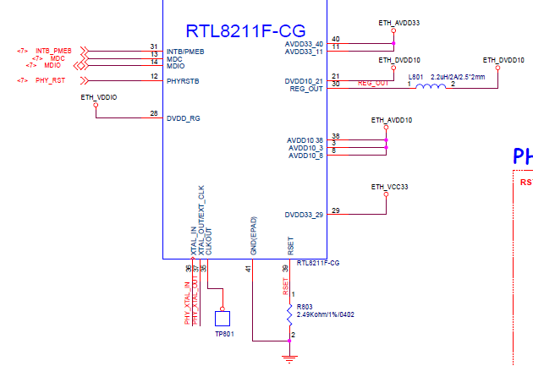
#7
Failure Analysis
7.5 Remove U801 location then measure impedance of NG1 and NG2 samples.
After removed U801 and measure impedance of NG1 & NG2 units, the P3V3 and ETH_DVDD10 power supplies wasn’t shorted with GND.
Suspect U801 material issue.
Continue to Measure impedance and VF of U801 component then compare with OK sample
Detect the pins of U801 component relate to ETH_DVDD10 and P3V3 power supplies was shorted and detail as table below:
Pin# | Description | NG1 sample |  | NG2 sample |  | OK Sample
 |  | Impedance (Ohm) | VF | Impedance (Ohm) | VF | Impedance (Ohm) | VF
3 | AVDD10 | 23.1 | 0.02 | 130 | 0.106 | 13.2K | 0.34
8 | AVDD10 | 23.1 | 0.02 | 129.4 | 0.105 | 13.22K | 0.34
11 | AVDD33 | 4.3 | 0.004 | 15.2 | 0.013 | 117.8K | 0.404
12 | PHYRSTB | 106.9 | 0.09 | 2.58M | 0.549 | 2.58M | 0.553
21 | DVDD10 | 146.5 | 0.122 | 2.42K | 0.39 | 2.29K | 0.369
29 | DVDD33 | 2.2 | 0.002 | 0.4 | 0 | 168.3K | 0.483
30 | REG_OUT/LDO_OUT | 0.3 | 0.001 | 0.3 | 0 | 0.899M | 0.34
31 | INTB/PMEB | 2.56M | 0.547 | 2.58M | 0.549 | 2.56M | 0.55
38 | AVDD10 | 17.11K | 0.411 | 18.06K | 0.422 | 18.03K | 0.422
40 | AVDD33 | 2.2 | 0.004 | 15 | 0.017 | 117.6K | 0.404
Result: The ETH_DVDD10 and P3V3 power supplies was shorted With GND due to U801 component issue and lead to NG1, NG2 samples can not boot.

Slide 14
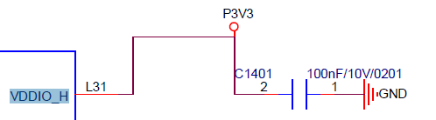
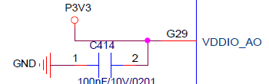

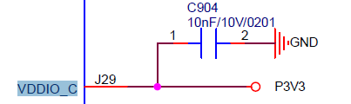
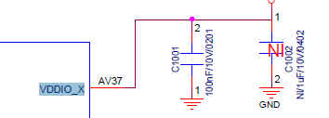
#7
Failure Analysis
7.6 Remove U801 and U1 locations then measure impedance of NG3 and NG4 samples.
After removed U801 and measure impedance of NG3 & NG4 units, the P3V3 power supply was still shorted with GND.
Continue remove U1 and measure impedance of NG3 & NG4 units, the P3V3 power supply was wasn’t shorted with GND.
Suspect U1 material issue.
Continue to Measure impedance and VF of U1 component then compare with OK sample
Detect the pins of U1 component relate to P3V3 power supply was shorted and detail as table below:
Measure Impedance and VF of U1 NG
Pin# | Description | NG3 Sample |  | NG4 Sample |  | OK Sample
 |  | Impedance | VF | Impedance | VF | Impedance | VF
L31 | VDDIO_H | 1.2 | 0 | 3.1 | 0.003 | 4.03M | 0.652
G29 | VDDIO_AO | 0.5 | 0 | 0.5 | 0 | 2.97M | 0.594
L29 | AVDD33_USB | 1 | 0 | 0 | 0.06 | 0.91M | 0.598
J29 | VDDIO_C | 0 | 0.06 | 1 | 0 | 5.94M | 0.641
AV37 | VDDIO_X | 3.1 | 0.003 | 1.2 | 0 | 2.74M | 0.605
Result: The P3V3 power supply was shorted With GND due to U801 component issue and lead to NG3, NG4 samples can not boot.

Slide 15
#7
Failure Analysis
7.7 Change new OK material for NG1 to NG4 samples then re-test at all test stations and OBA
Change new U801 material for NG1 and NG2 then re-test at all test stations and OBA
Change new U1 material for NG3 and NG4 then re-test at all test stations and OBA
The result as table below:
NG# Station | NG1+NG2 ( Change new U801) | NG3+NG4 (Change new U1) | Remark
FATP | Pass | Pass | Retest all functions of 4 NG samples at all test stations and OBA after changing new material. ➔ Result: PASS
OBA | Pass | Pass

Slide 16
#8
Conclusion
NG1+NG2 samples: U801 component issue lead to P3V3 and ETH_DVDD10 power were shorted with GND ➔ Products couldn’t boot up.
NG3+NG4 samples: U1 component issue lead to P3V3 power shorted was with GND ➔ Products couldn’t boot up.
NG5 sample: burnt at R823, R824, R825, R826 ➔ Can’t further analyze and repair.

Slide 17
#9
Action
SQE send NG U801 and U1 materials to vendor for further analysis (Owner: Mr. Ha, On-going)

